Slide 1




Gen AI Tool 1
Automated Impact Assessment Form Completion
GEHC

Slide 2

POC Objective
Tool to leverage AI/Gen AI capabilities to analyze the context of a proposed design changes and automatically populate relevant sections of the 147-question impact assessment form.
The AI will be trained on relevant GE HealthCare anonymized historical design change data and its relevant assessment form.
Training: GA2.1.2 to 2.1.5, Testing: GA2.1.6
Success Criteria
Target Accuracy ~ 60–70%

Slide 3
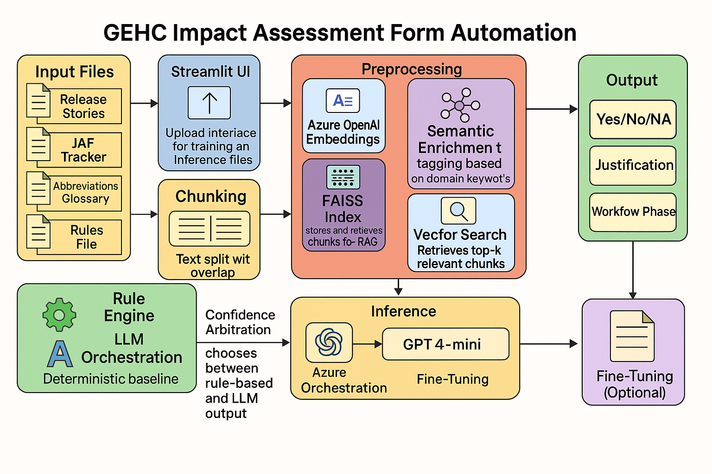
Technical Architecture

Slide 4
Training Phase
Input Data
1.Release stories
2.IAF Tracker 3.Abbreviations
4.Glossary
5.Rules file (GA 2.1.2 to 2.1.5)
Preprocessing
Cleaning & Normalization
Chunking with overlap
Semantic Enrichment Labelling
Output
Azure Open AI Fine-Tuned Model (on top of gpt-4o-mini model)
Model Training
Fine-tune using Azure OpenAI
Supervised training on labelled data

Slide 5
Inference Phase
1) Validation
Single question
Predicted: Yes /No/NA
Justification
Workflow phase
Preprocessing
Chunking with overlap
Semantic tagging (glossary +rules)
Embedding generation
FAISS Indexing (separate namespaces for NA & release)
Vector search (top-k retrieval)
Input
New release stories
2) Batch Validation
Export to csv
Prediction Logic
Fine-tune model using Azure OpenAI
Default Rules for NA
3) Offline Evaluation
Actual vs Predicted
Performance benchmark

Slide 6
Tech Stack
Programming Languages : Python
Core Libraries
pandas – Data manipulation
numpy – Vector operation
faiss – Similarity search index
openpyxl – Excel file handling
json – Metadata serialization
dotenv – Environment variable management
Cloud Services
Azure OpenAI
Embedding Model: text-embedding-ada-002
Fine-Tuned Chat Model: gpt-4o-mini(Base)
Vector Store : FAISS

Slide 7
Training Data Insights
Input Type | Count | % of Total
Defects | 97 | 72.4%
Features | 34 | 25.4%
Total Inputs | 134 | 100%
Observations on SW Change set data:
Defects (72.4%): Limited contextual information in the SW Change set.
Features (25.4%): Limited contextual information in the SW Change set.
Inefficient explanation on impact metrics, most of which are defaulted.

Slide 8
Training Data Insights (Contd..)
Release Number | NA | NO | YES | Total
GA2.1.2 to 2.1.5 | 275 | 237 | 76 | 588
Overall % | 46.77% | 40.31% | 12.93% | 100.00%
Observations on IAF data:
Observed Class Imbalances.
YES, entries are sparse, making it difficult for the model to learn consumer-impact patterns.
NO entries are more frequent but often lack actionable consumer relevance.
The dominance of NA may bias the model toward neutral predictions. Note: Handled defaults via Rule Engine to avoid the bias

Slide 9
Actual vs Predicted – Evaluation Summary
Release Evaluated: GA2.1.6
Total Questions: 147
Label | GT Count | TP Count | Accuracy %
✅ YES | 27 | 14 | ~52%
✅ NO | 64 | 46 | ~72%
✅ NA | 56 | 42 | ~75%
🔵 Total | 147 | 102 | ~69%
Observations impacting accuracy:
Minimal Training dataset
Class Imbalances for training
Limited contextual Information on the SW Change set
Limited Workflow phase information
Relevant Story Prediction to be improvised with rich contextual information
Notes:
📊 Accuracy Calculation
1. Individual Accuracy (Per Label)
Formula:
$${\text{Accuracy}}_{\text{Label}}=\frac{\text{True} \text{Positives}\text{ (}\text{TP}\text{)}}{\text{Ground} \text{Truth} \text{Count}\text{ (}\text{GT}\text{)}}$$
Examples:
YES: $\frac{14}{27}=0.5185 \text{or} 51.85\%$
NO: $\frac{46}{64}=0.7188 \text{or} 71.88\%$
NA: $\frac{42}{56}=0.7500 \text{or} 75.00\%$
2. Total Accuracy (Overall)
Formula:
$$\text{Total} \text{Accuracy}=\frac{\sum{\text{TP}}}{\sum{\text{GT}}}=\frac{102}{147}=0.6939 \text{or} 69.39\%$$

Slide 10
Guidance for Improving Accuracy
1. Balanced Training Data
Ensure balanced representation of YES, NO, and NA responses
Include clear justifications and workflow phases for each response
Expand training samples for better learning
2. Better Input Quality
Enrich context for each design change
External Integration with SPR/RALLY for detailed insights
Streamline the default behavior across releases
3. Stronger Evaluation Process
Further Fine Tuning for Accuracy Improvement
Use confidence scores to flag uncertainty
Validate with realistic test scenarios
4. Improved AI Guidance
Provide clear decision-making instructions
Blend AI predictions with business rules

Slide 11



Thank you
Innovative Services
Passionate Employees Delighted Customers
www.hexaware.com | © Hexaware Technologies. All rights reserved.

